Slide 1
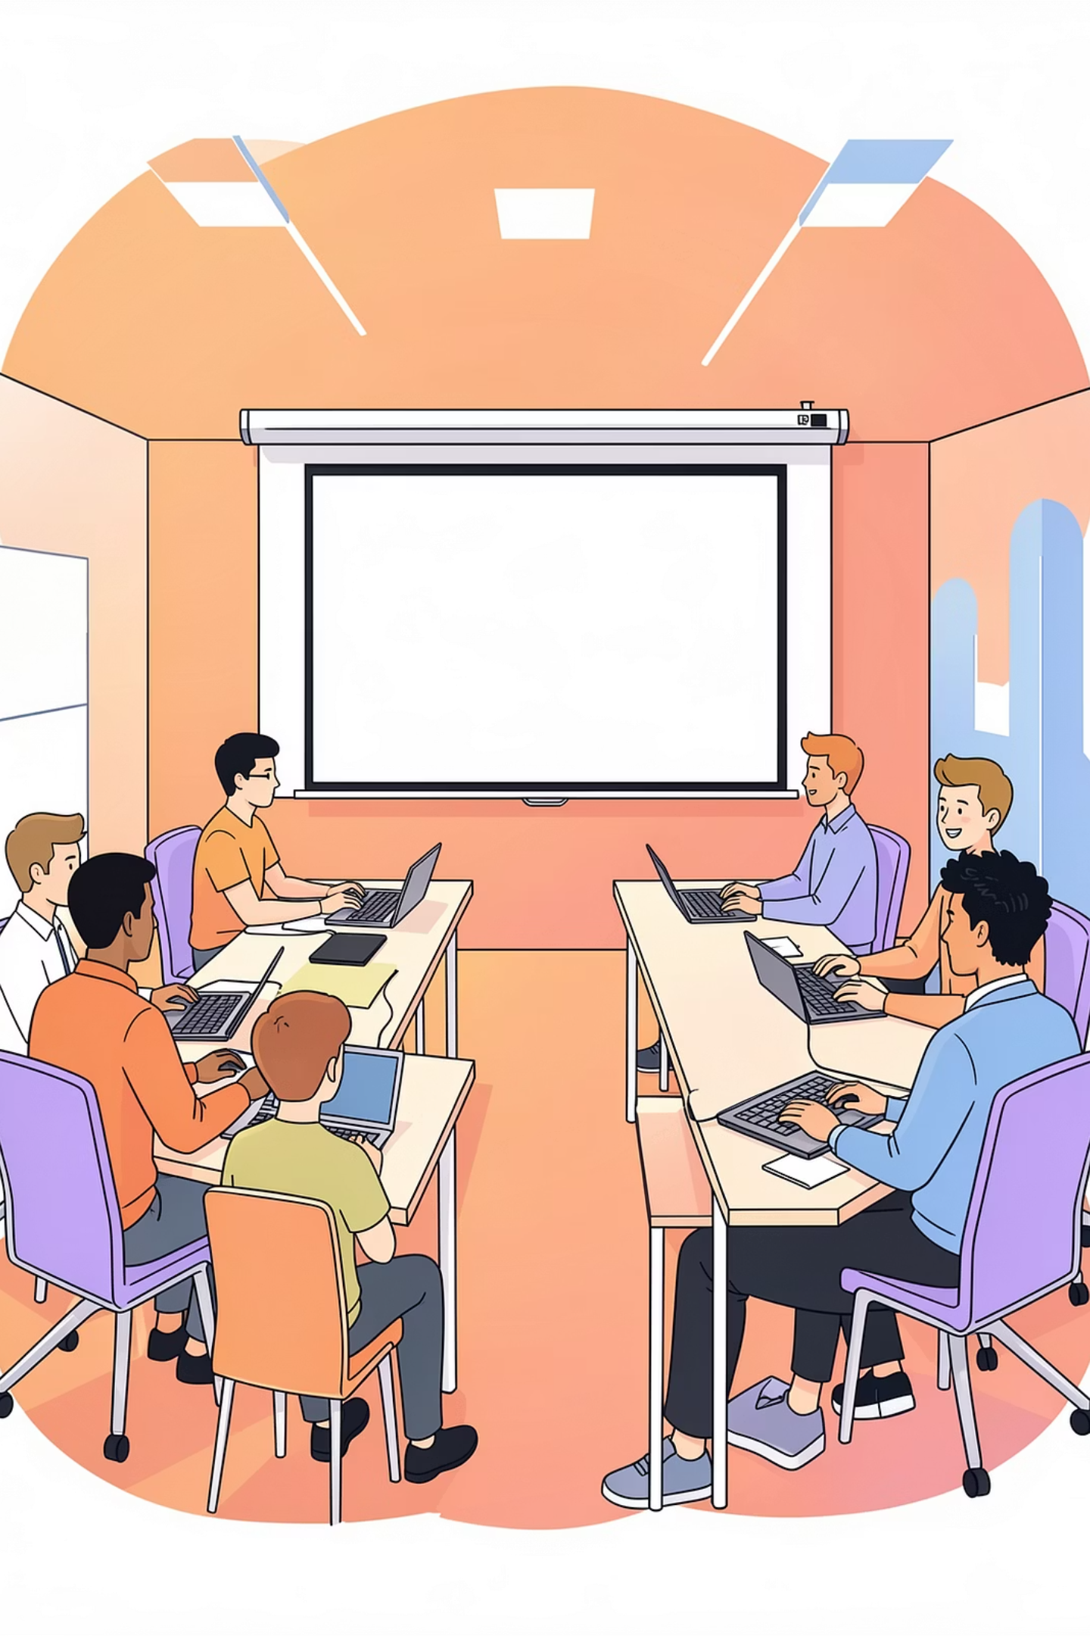
Effective Communication Skills
Welcome to a focused training session designed for freshers and IT trainees. We'll explore practical communication habits that lead to workplace success. This interactive session mixes short theory, real-world examples, and activities.

Slide 2
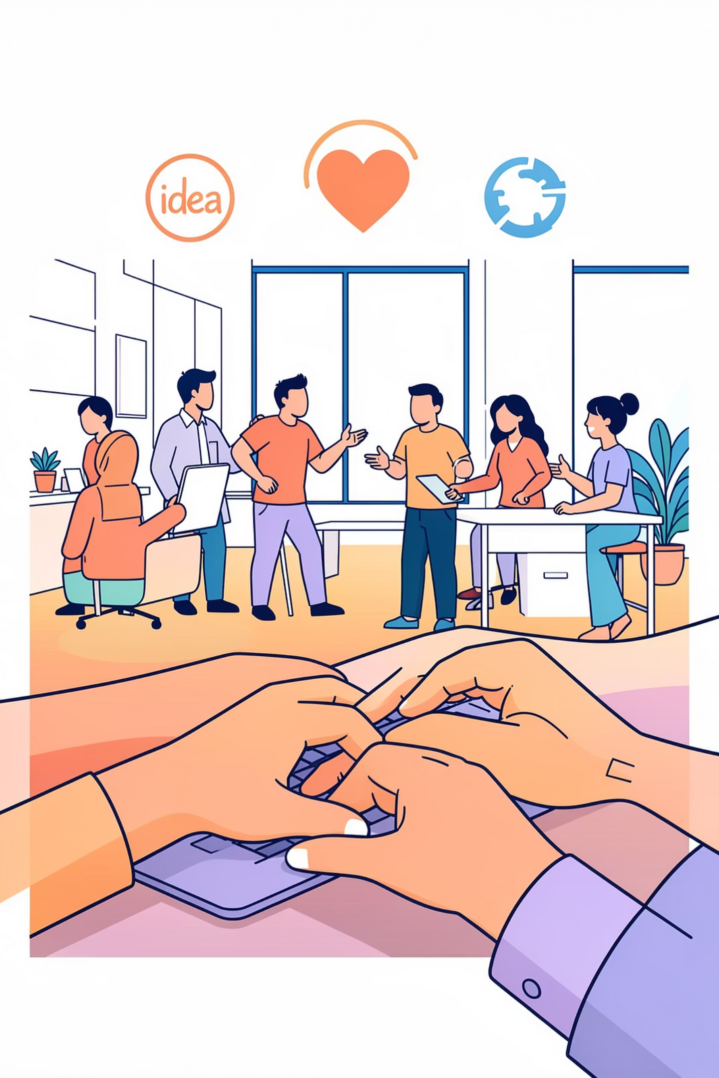
What is Communication?
Sharing ideas
Conveying concepts clearly to teammates and stakeholders.
Expressing emotions
Communicating feelings and intent to create empathy.
Building connections
Forming trust and understanding through regular, meaningful exchange.

Slide 3


Importance of Communication
Builds trust
Consistent, honest messages establish credibility with peers and leaders.
Improves teamwork
Clear roles and feedback speed up collaboration and reduce rework.
Achieves goals
Aligned communication keeps projects on track and drives measurable results.

Slide 4

Interactive Question
What does communication mean to you?
Why is it important?
Share one example
Pair up and discuss one impact of good communication you’ve seen.
Volunteer a short real-world example that helped solve a problem.
Quick share: one phrase from each participant (20–30 seconds).

Slide 5

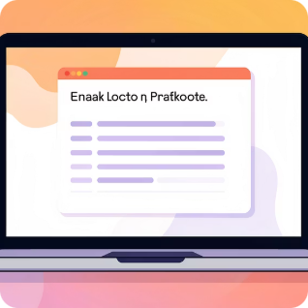
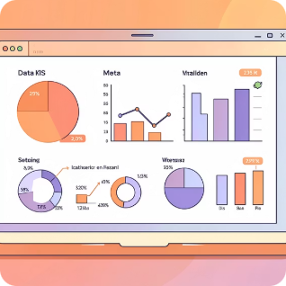
Types of Communication
Verbal & Non-Verbal
Written communication
Visual communication
Spoken words plus tone, posture, and gestures that support meaning.
Emails, chats, and documentation—clarity and structure are essential.
Diagrams, charts, and mockups help complex ideas become obvious fast.

Slide 6
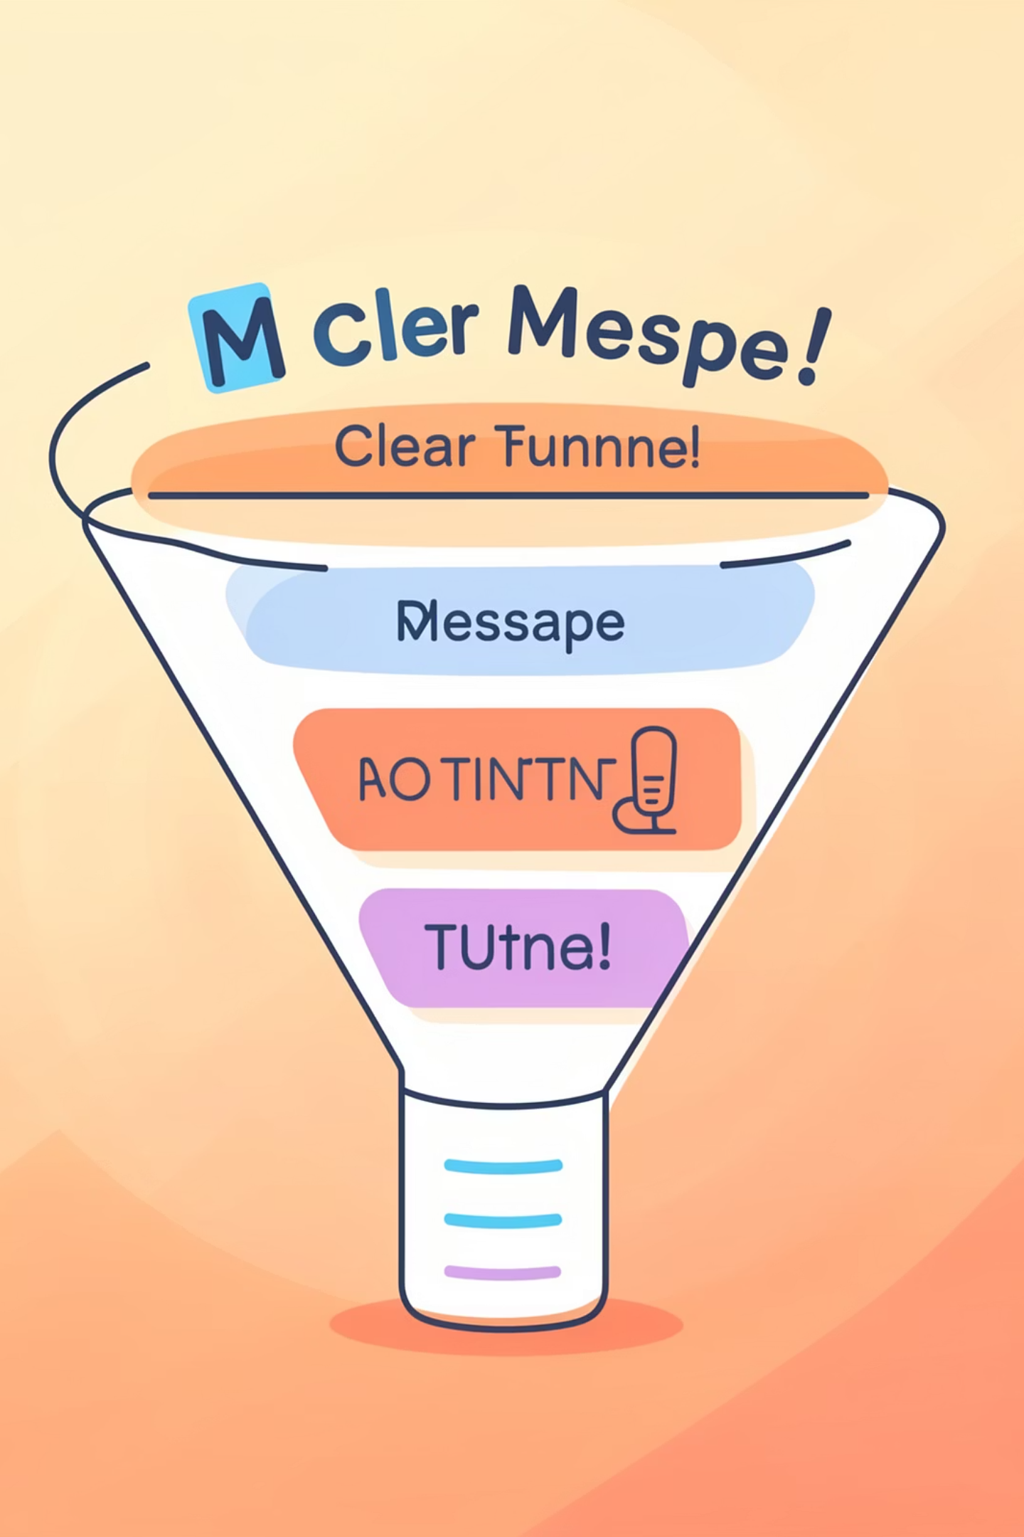
Importance of Clarity
Simple messages
Less confusion
Saves time
Structured messages reduce misinterpretation and unnecessary follow-ups.
Concise communication speeds decision-making and execution.
Use plain language, one idea per sentence, and actionable requests.

Slide 7

Tone & Body Language
Voice tone matters
Match tone to context—calm for updates, energetic for motivation.
Facial expressions
Expressions reinforce sincerity—smiles and attentive faces invite dialogue.
Eye contact
Appropriate eye contact builds trust and shows active engagement.

Slide 8

Digital Age Communication
Online is fast
Tone is missing
Be clear always
Expect quick turnarounds; choose concise formats for routine updates.
Use emojis, formatting, or a short clarifying sentence to avoid ambiguity.
Subject lines, clear actions, and deadlines prevent confusion across channels.

Slide 9
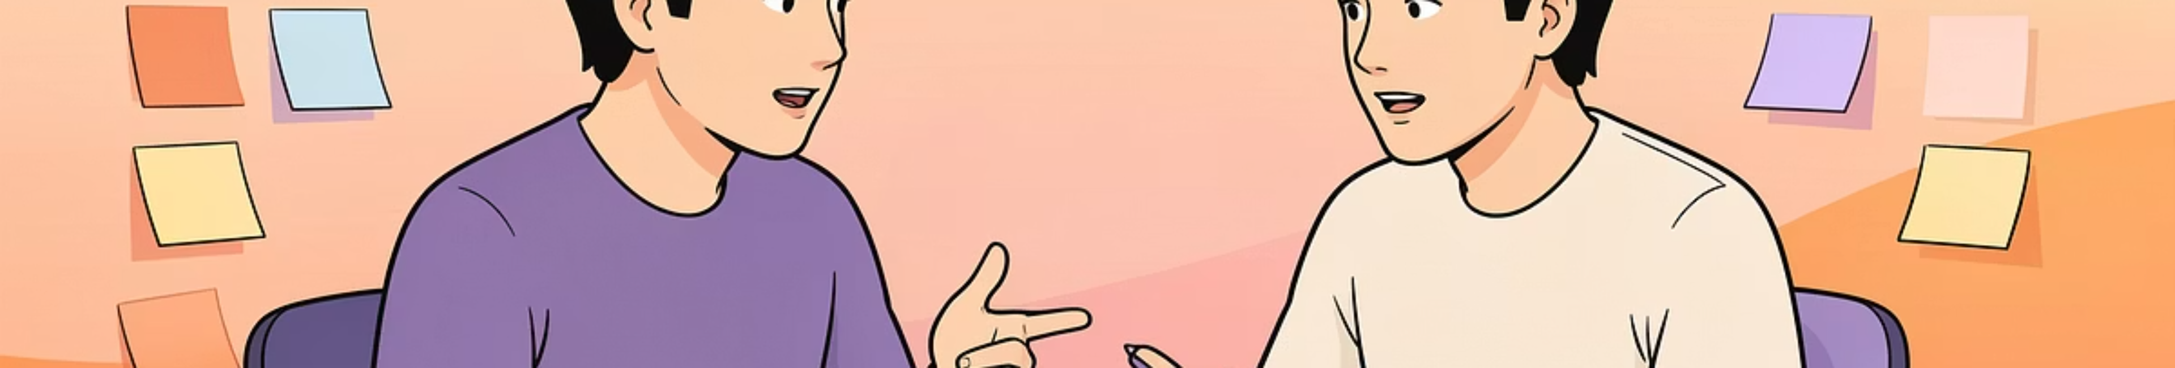
Barriers + Mini Activity
Partner discussion
Emotional stress
Mini activity: pair up for 5 minutes to practice reflective listening and summarize.
Poor listening
Stress skews messages; pause and reframe before responding under pressure.
Interruptions and multitasking reduce understanding—practice active listening.

Slide 10

Key Takeaways
Speak clearly
Use body language
Build confidence
Focus on short sentences, clear purpose, and specific next steps in every message.
Align tone, facial expressions, and posture to reinforce your verbal message.
Practice regularly, request feedback, and iterate—confidence grows with experience.

